Slide 1
Module 5
Randomized Path Planning

Slide 2
Robot's configuration
Specification of the positions of all the points of the robot
Robots are constructed of rigid bodies (rigid bodies links)
rigid bodies links are connected by joints
The links are rigid and have a constant shape, we typically only need a few numbers to represent the configuration of a robot.

Slide 3
Robot's configuration
The configuration of a robot is a representation of the positions of all the points of the robot
The configuration space, which we often call the C-space for short, is the space of all configurations of the robot.
The number of degrees of freedom is the dimension of the C-space, or the minimum number of real numbers you need to represent the configuration.

Slide 4
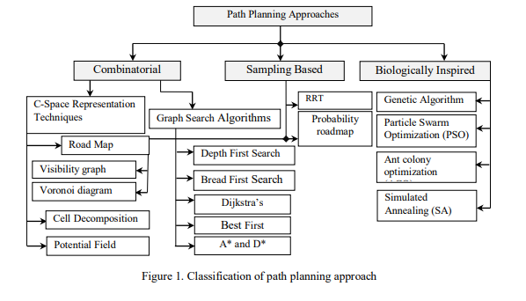
Path planning Approaches

Slide 5
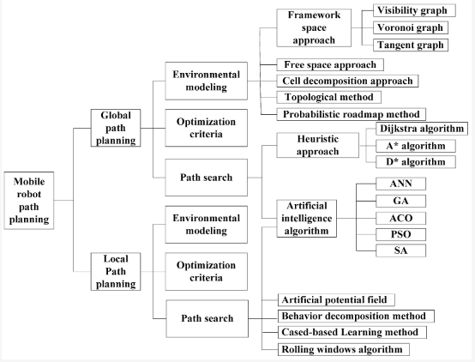

Slide 6
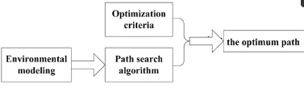
Global Path Planning
Environmental modeling
Optimization criteria
Path search algorithm

Slide 7
Environmental Modeling
A suitable environmental model will help to better understand the environmental variables, reduce unnecessary planning and greatly reduce the number of computations
Framework space approach, free space approach, cell decomposition approach, topological method and probabilistic roadmap method

Slide 8
Environmental Modeling
The mobile robot is usually reduced to a point.
The obstacles around the mobile robot are scaled, the mobile robot can move freely in the obstacle space without colliding with obstacles and boundary.
Visibility Graph, Voronoi graph and Tangent graph

Slide 9
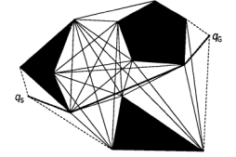
Visibility Graph
Visibility graph (VG) algorithm finds a path by connecting all the visible vertices of an obstacle including a starting and an ending point. After that, a shortest path is searched from the connected graph.

Slide 10
Visibility Graph
How does a Mobile Robot get from qs to qG?
• Assume robot is a point in 2-D planar space
• Assume obstacles are 2-D polygons
• Create a Visibility Graph:
Nodes are start point, goal point, vertices of obstacles
– Connect all nodes which are “visible”
– straight line un-obstructed path between any 2 nodes
– Includes all edges of polygonal obstacles

Slide 11
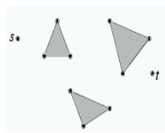
Visibility Graph
Problem - We are given a set of n disjoint polygonal obstacles in the plane, and two points s and t that lie outside of the obstacles. The problem is to determine the shortest path from s to t that avoids the interiors of the obstacles.

Slide 12
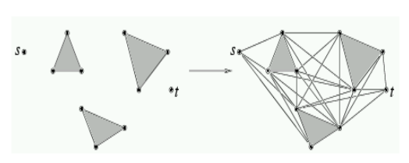
Visibility Graph
Claim - The shortest path between any two points that avoids a set of polygonal obstacles is a polygonal curve, whose vertices are either vertices of the obstacles or the points s and t.

Slide 13
Visibility Graph
In the range of the polygon, a vertex is connected to its total adjacent points, so the mobile robot can move along the polygon edge.
Search the set of these lines and select an optimum path from the starting point to the end point.
This method can successfully solve the small size problem in two-dimensional space and the path is optimal, but its time complexity is O(N2)
Higher dimension space- NP-hard problem
Mobile robot has a certain size and shape, all paths pass the end of obstacles, so the obtained path planning is likely to have a collision.

Slide 14
Visibility Graph
Visibility graph path planning has the problem that we navigate along the vertices of grown polygons. If we are not careful, we can come very close to actual obstacles if our growing is incorrect, or more realistically, mobile robot control has some errors in it

Slide 15
Voronoi graph
A better idea may be to try to find paths that are not close to obstacles, but in fact as far away as possible from obstacles. This will create a maximal safe path, in that we never come closer to obstacles than we need.
To do this, we will look at the Voronoi Diagram in the plane. Let P = {p1, p2, . . . , pn} be a set of points in the plane called sites.
The Voronoi diagram is the sub-division of the plane into n distinct cells, one for each site. Each cell has the property that a point q corresponds to a site pi. iff dist(q, pi) < dist(q, pj) for each pj ∈ P with j ≠ i

Slide 16
Voronoi Graph
A Voronoi diagram can be used to find out the trading area of a region . If you are planning to open a new Home Depot store, you want to know what region it will serve, and how this will relate to exisitng Home Depot’s in the region. Assuming people go to the nearest Home Depot, you can create a Voronoi diagram which shows how a region will be subdivided by adding more stores in the region (note: this assumes a Euclidean distance metric which may not be applicable with travel by car on existing roads).

